Slide 1
Vision and Brain
Vision and Brain
How We Perceive the World
3. Depth
Zhigang Zhu, Herbert G. Kayser Chair Professor
Department of Computer Science
CUNY City College and Graduate Center

Slide 2
Acknowledgments
Textbook:
Vision and Brain - How We Perceive the World, By James V. Stone, The MIT Press
Slides:
Most of the figures were taken from the textbook (with permission for use in this class). Please do not distribute or use them for other purposes

Slide 3
Outline (Ch. 5)
Depth: The Rouge Dimension
Motion: What Is It Good For?
Stereopsis: Stereo Vision
Shape from X (optional)
Motion, Stereo, Shading, Texture

Slide 4
Outline (Ch. 5)
Depth: The Rouge Dimension
Motion: What Is It Good For?
Stereopsis: Stereo Vision
Shape from X
Motion, Stereo, Shading, Texture

Slide 5
Depth: The Rouge Dimension
Space: the First Frontier
Painting Pictures on the Retina
Pictorial Cues to Distance

Slide 6
Seeing Requires Work!
Seeing is not a passive process. It requires work.
The major limiting factor with regard to brain function might not be size or weight but the energy required to keep it running.
First, having a bigger brain requires a bigger intake of food.
Second, the large energy requirements of neuronal action potentials mean that brain cells should be active as little as possible
Seeing consists in creating a particular representation of the visual world inside our heads

Slide 7
Space the First Frontier
Room as three-dimensional space. The X-axis defines position from left to right, the
Y-axis from bottom to top, and the Z-axis from back to front (depth). A spider
requires three numbers, the distance from the origin along the X-, Y-, and Z-axes to
specify its position in the room (e.g., [X, Y, Z] = [3, 2, 1]). By definition, the origin
is located at [0, 0, 0].

Slide 8
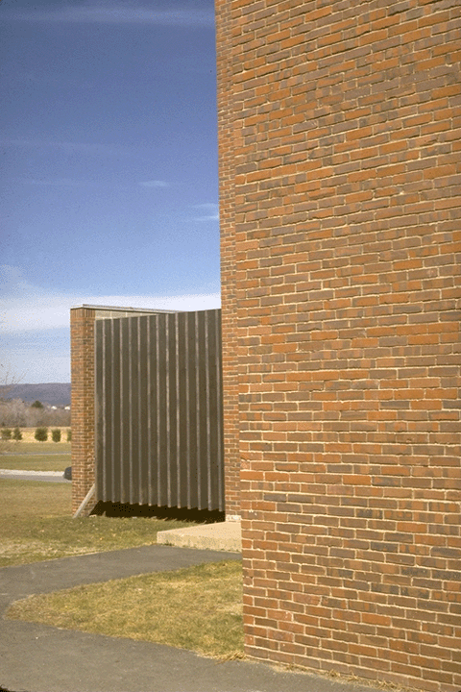
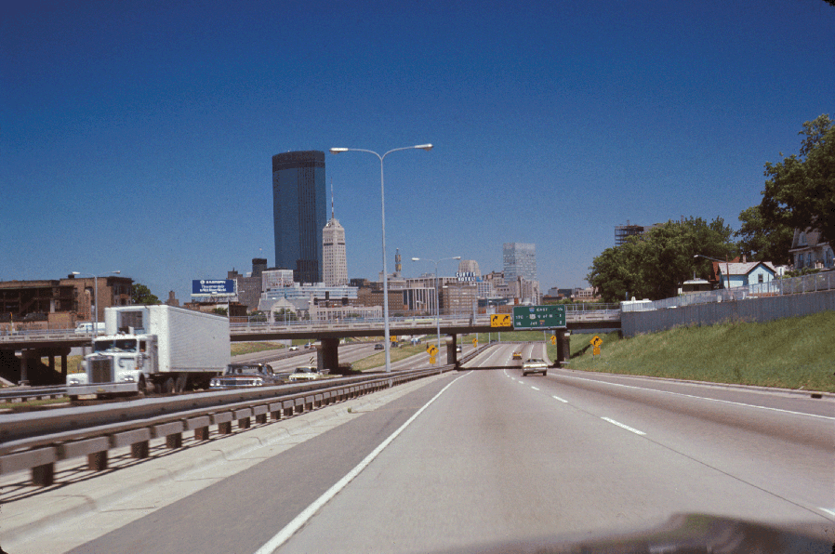
Painting Pictures on the Retina
Whereas adjacent points in the 3-D world always yield adjacent points in the 2-D image, but adjacent points in the 2-D image could come from points separated by miles in the 3-D world.
In other words, there’s a continuous mapping from the world to the image, but a discontinuous mapping from the image to the world.

Slide 9
Pictorial Cues to Distances
Interposition: occluding objects appear closer than occluded objects
Relative size: when objects have approximately the same physical size, the larger object appears closer
Relative height: objects lower in the image appear closer
Linear Perspective: objects appear smaller as they recede into the distance
texture gradients
Aerial Perspective: change in color and sharpness as object recede into the distance
Illumination gradients: gradients and shadow lend a sense of depth

Slide 10
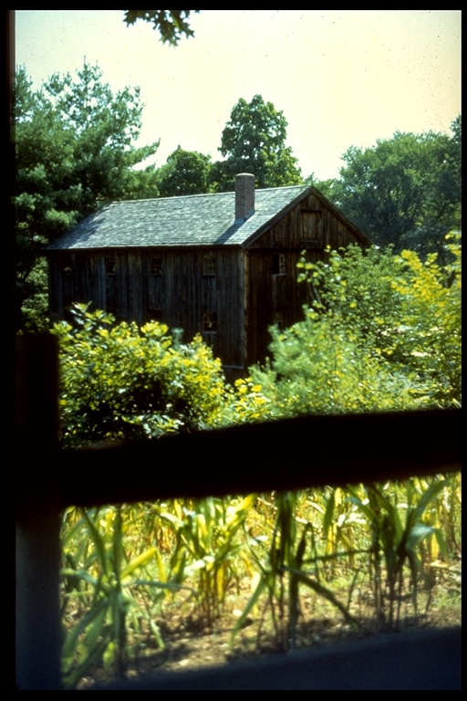
Interposition

Slide 11

Interposition

Slide 12
Interposition

Slide 13
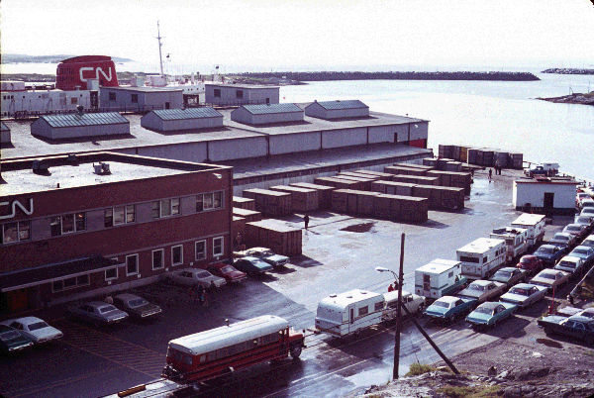
Different viewpoint
Notes:
linear perspective

Slide 14
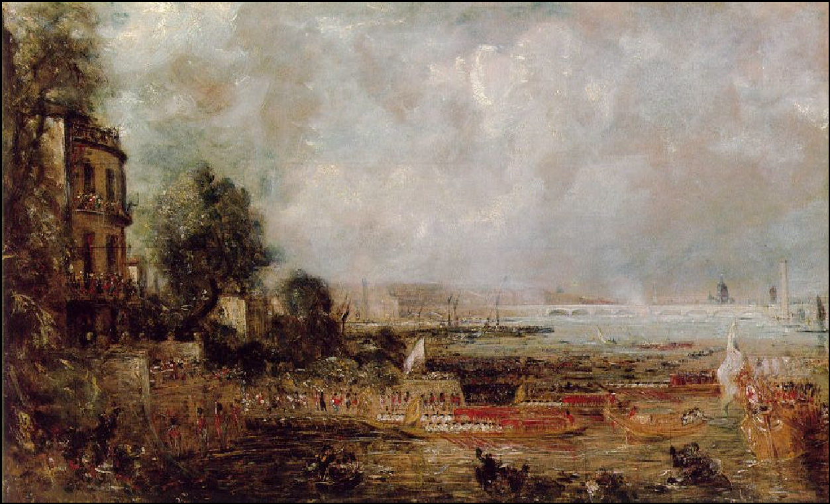
Aerial Perspective
Constable
Notes:
Aerial Perspective: change in color/shade and sharpness as object recede (diminish) into the distance

Slide 15
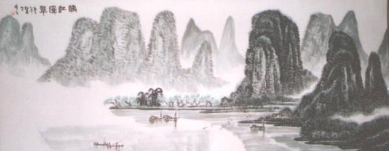
Aerial Perspective
Classic Chinese Paintings

Slide 16
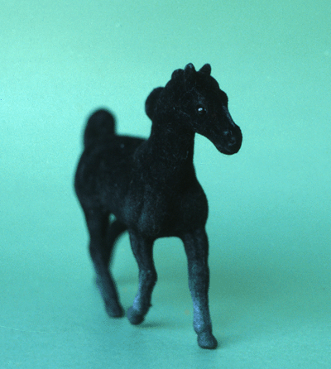
Absolute Size

Slide 17
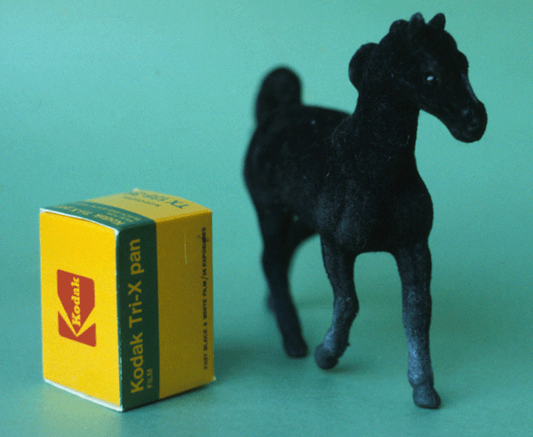
Relative Size

Slide 18
Relative Size

Slide 19
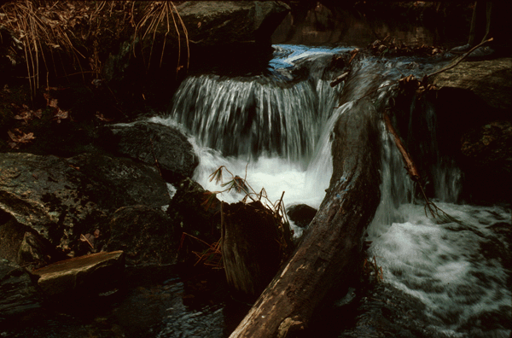
Absolute Size

Slide 20
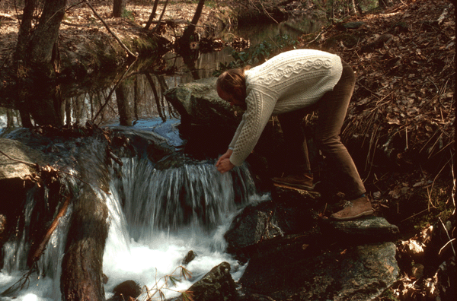
Relative Size

Slide 21
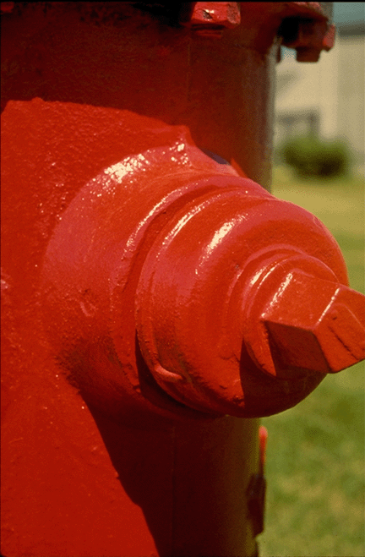
Light and Surfaces

Slide 22

Light and Surfaces

Slide 23
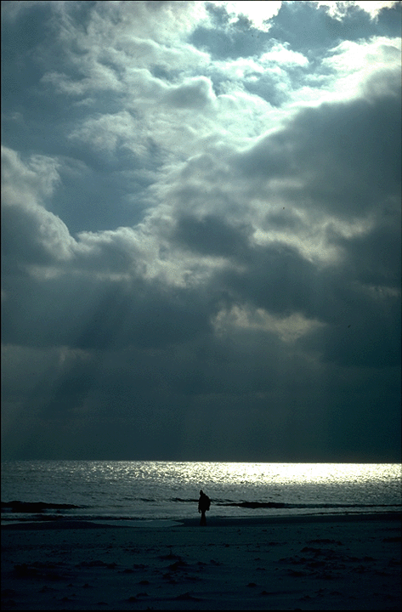
Light and Surfaces

Slide 24
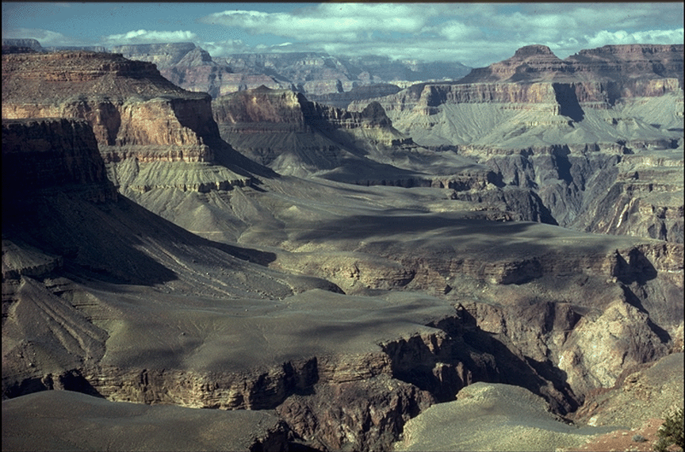
Light and Surfaces

Slide 25
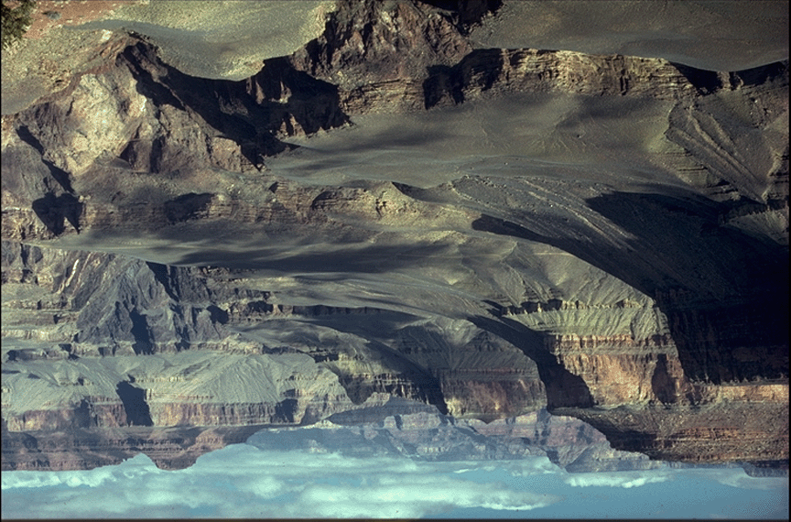
Light and Surfaces

Slide 26
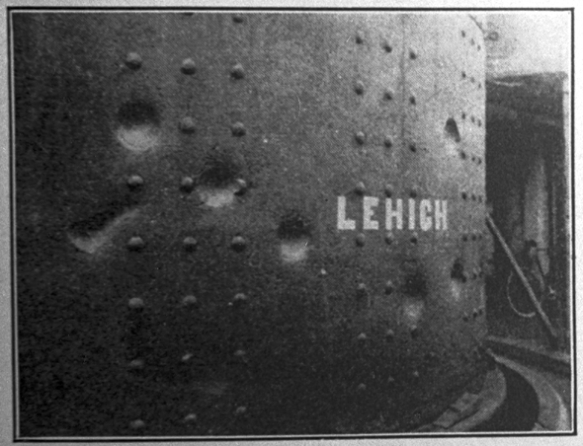
Light and Surfaces
C. H. Stoelting Company

Slide 27
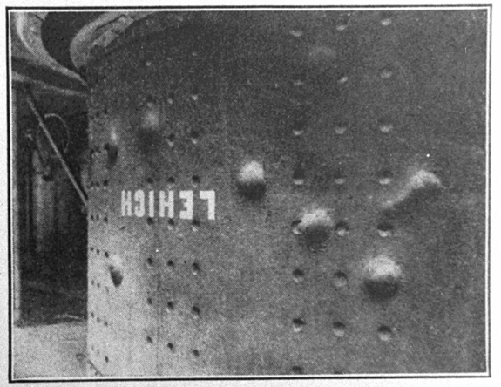
Light and Surfaces

Slide 28
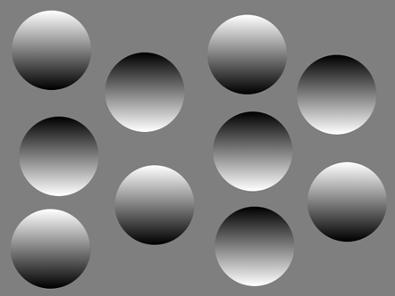
Light and Surfaces
Notes:
Rotate the projector to see the changes of the dots from bumps to ditches (convex to concave)

Slide 29
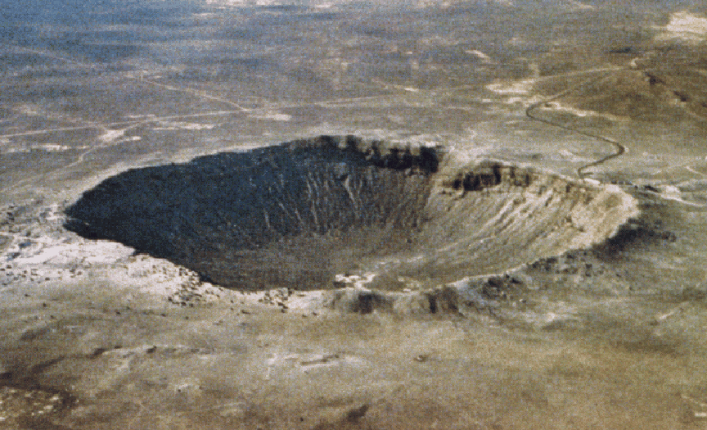
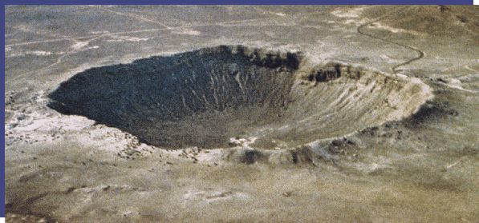
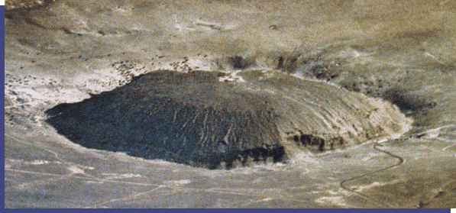
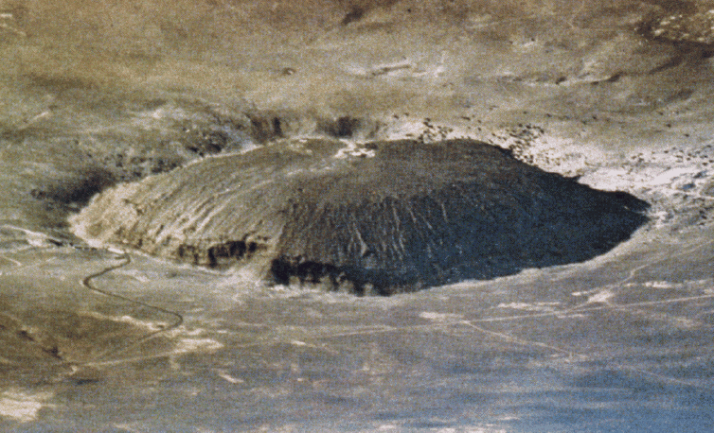
Light and Surfaces

Slide 30
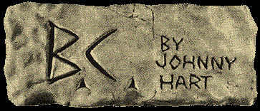
The Effect of Perspective

Slide 31

Texture Gradient
Sunflowers in Fargo, ND
Photo by Bruce Fitz
http://www.ars.usda.gov/is/graphics/photos/

Slide 32
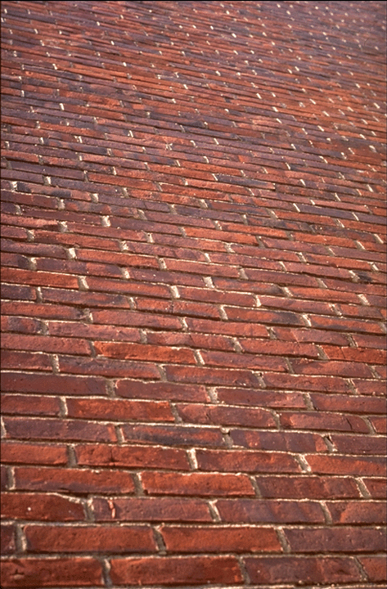
Texture Gradients

Slide 33
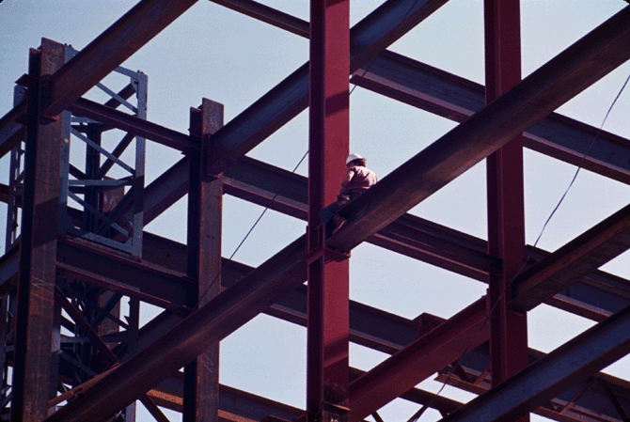
Edges

Slide 34
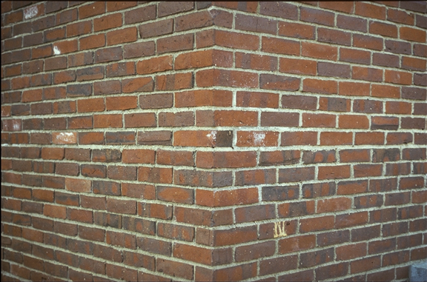
Texture Edges

Slide 35
Outline (Ch. 5)
Depth: The Rouge Dimension
Motion: What Is It Good For?
Stereopsis: Stereo Vision
Shape from X
Motion, Stereo, Shading, Texture

Slide 36
Motion: What Is It Good For?
Temporal Contrast Sensitivity
Motion Parallax and Optical Flow
Motion Blur
Shape from Motion
How Much Structure from How Much Motion

Slide 37
Temporal Contrast Sensitivity
We have the highest temporal resolution for changes that happen about 10 times per second, or 10 Hz.
We’re almost blind to changes above about 30 Hz, which is why we see the images in a movie, projected at a 30 frames per second, as continuous motion, rather than as the sequence of static images they really are.
30 Hz
Ability to detect flicker at different flicker
rates defines the temporal contrast sensitivity function. Note both axes are logarithmic.

Slide 38
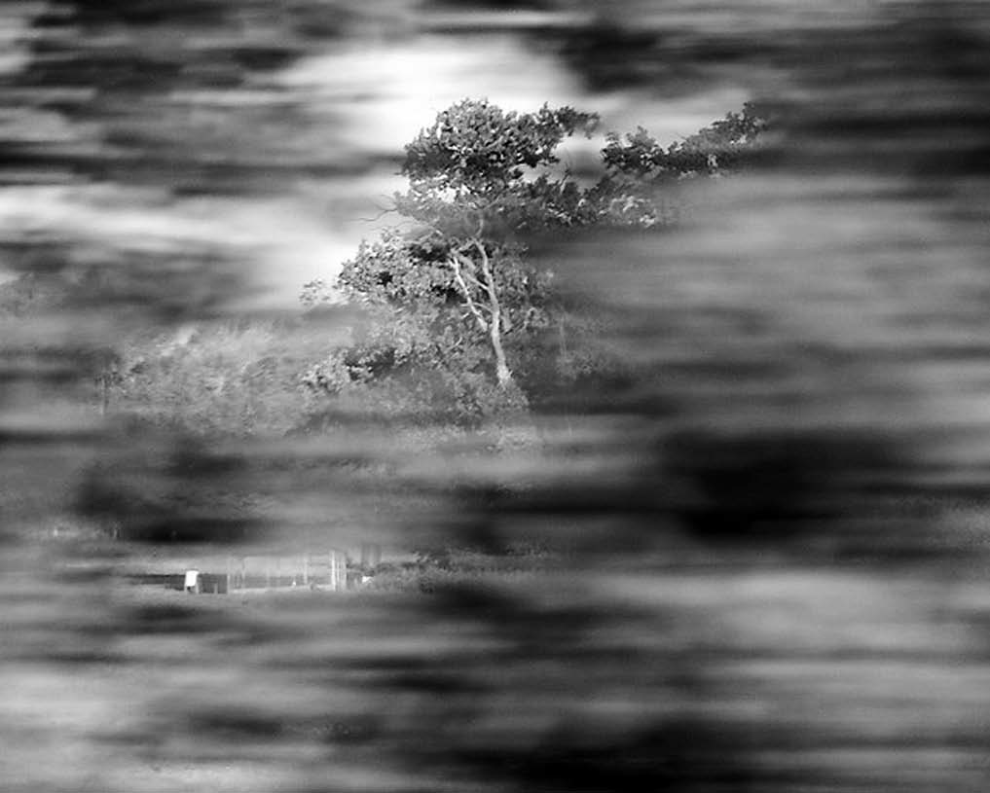
Motion Parallax
Motion parallax is caused by the differential speed with which stationary objects move across the retinal image, a speed which depends on their distances from a moving observer looking at a single point (called the “fixation point”) in the world
Extreme example of motion parallax. This picture was taken from a moving train. The bushes in the foreground are blurred by their rapid motion across the image, whereas the trees in the background remain relatively sharp.

Slide 39
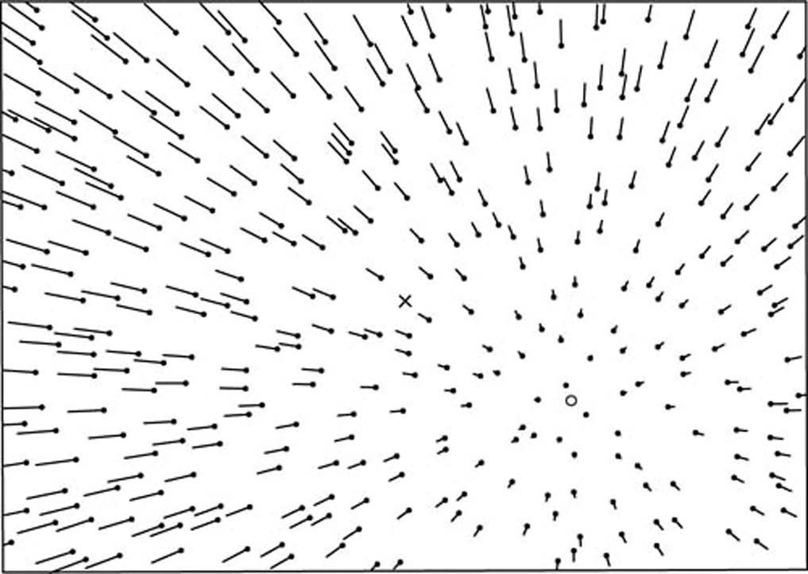
Optical Flow
When an insect flies toward a
particular point, the visual world appears to flow around the insect (viewer), with nearby points having greater speed across the eye’s images than distant points. This optic flow field has zero speed only at the point to which the insect is heading, and it is therefore called the “focus of expansion” -FOE
Pattern of optic flow resulting from motion, as if the observer is traveling into a tunnel.

Slide 40
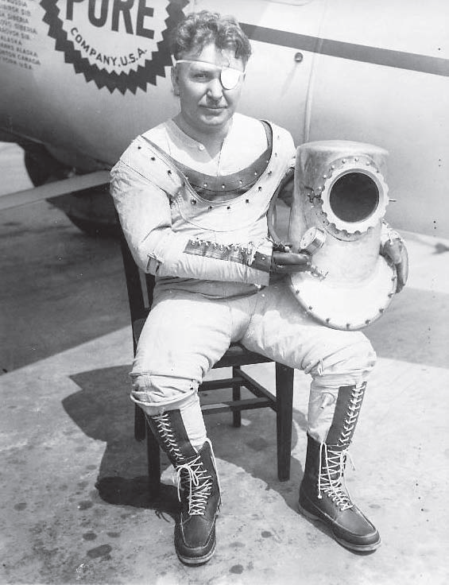
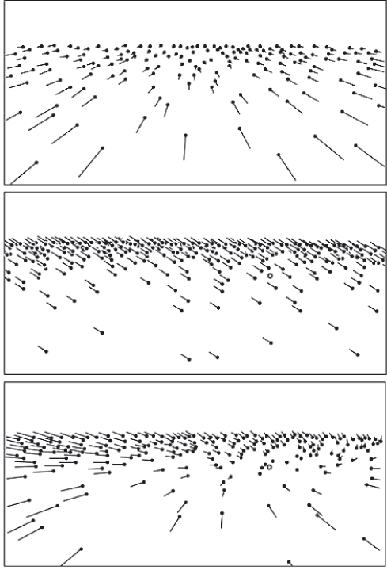
Motion Parallax & Optical Flow
T
R
T+R
Wiley Post, shown here wearing an early high-altitude pressure suit, made the first solo flight around the world in less than eight days during 1933, despite having only one eye.

Slide 41
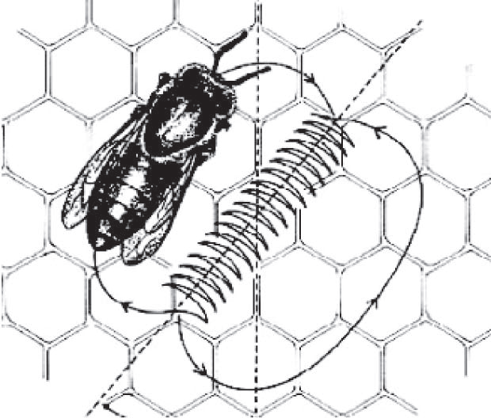
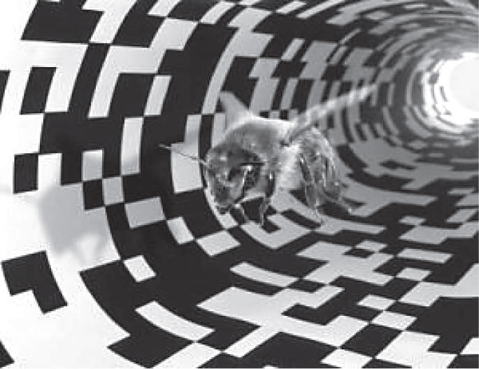
Motion Parallax & Optical Flow
Bees use optic flow to measure distance. The waggle dance of the bee tells other
bees where to find food. Because this “distance” seems to be measured in
terms of the amount of optic flow encountered by the dancing bee on her way to
the food, placing a fine texture in a tunnel that leads to a food source makes the
bee think she has traveled farther than she really has.

Slide 42
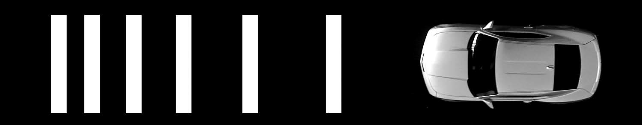
Motion Parallax & Optical Flow
Optic flow. The width of stripes on both sides of the road shrinks as the road
approaches a junction. This increases the optic flow experienced by drivers, tricking them into slowing down.

Slide 43
Motion Parallax & Optical Flow
Prove this is true:
The optics of vision dictate that the retinal speed s of an object at an optic angle θ (theta) from the insect’s heading direction (i.e., from the FOE) is determined by the insect’s speed v, and the object’s distance d. For objects that are almost straight ahead, a “small angle” approximation yields
d ≈ vθ/s
where the symbol ≈ means “approximately equal”
v
FOE
θ
d
s

Slide 44
Pure Translation: will discuss in visual motion
Pure Translation (ω =0)
Radial Motion Field (Tz <> 0)
Vanishing point p0 =(x₀, y₀)^{T} :
motion direction
FOE (focus of expansion)
Vectors away from p0 if Tz < 0
FOC (focus of contraction)
Vectors towards p0 if Tz > 0
Depth estimation
depth inversely proportional to magnitude of motion vector v, and also proportional to distance from p to p₀
Parallel Motion Field (Tz= 0)
Depth estimation:
depth inversely proportional to magnitude of motion vector v
Tz =0
Notes:
Draw FOE on blackboard
Derive the relation when Tz = 0 and Tz <>0
(1) Tz = 0
(v_{x}, v_{y}) =(-f Tx , -f Ty) /Z = -f/Z (Tx, Ty)
Note: parallel velocity field
(2) Tz <>0
(v_{x}, v_{y}) =(xTz - f Tx , yTz - f Ty) /Z = Tz / Z ( x – f Tx/Tz, y – f Ty/Tz)= Tz (x-x0, y-y0) /Z
Note: vx/ vy = (x-x0) / (y-y0)
Where FOE (x0, y0) = f/Tz (Tx, Ty)
v = |(vx,vy)|

Slide 45
Motion Blur vs Focus Blur
Focus blur is caused by each point in a scene being smeared out over
many photoreceptors, such that many scene points contribute to the input
to each photoreceptor

Slide 46
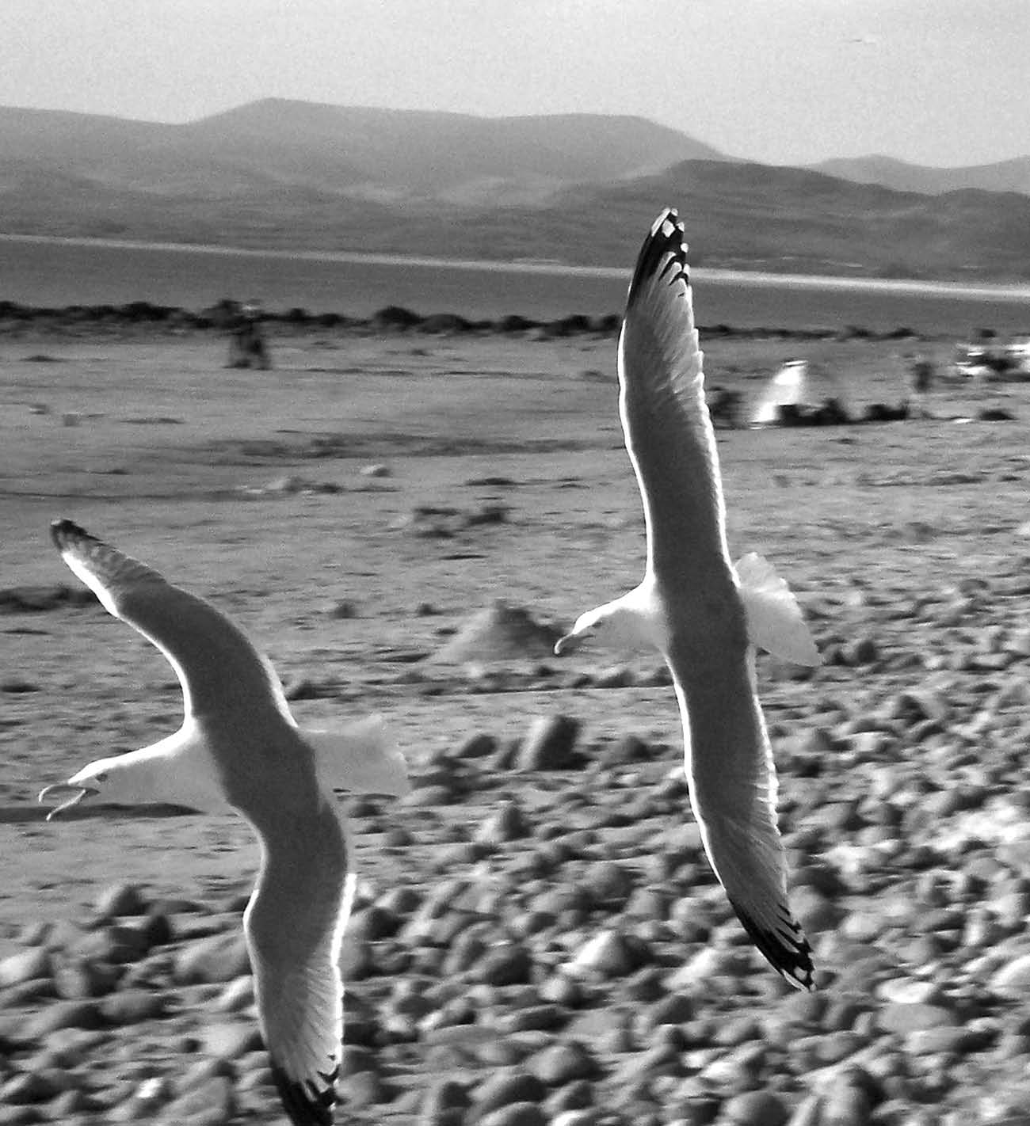
Motion Blur vs Focus Blur
Motion blur. The blurred background is caused by the rapid motion of the camera as it tracks the motion of the seagulls.
So why do we experience motion blur? Because each photoreceptor
needs a small interval of time to build up its response to the light from the small patch of scene that happens to be hitting it.

Slide 47
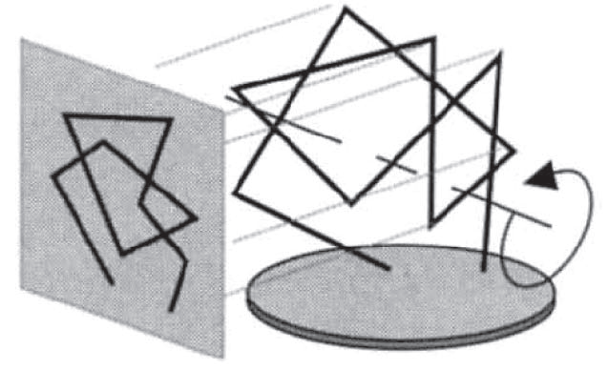
Shape from Motion
Just as motion parallax can tell us the distances to points in a scene if we are moving, so it can also tell us the distances to points on an object if the object is moving.
In particular, if an object is rotating, even by a small amount, then the relative speeds in the retinal image of nearby features on the object are determined by their relative distances, and therefore give some idea of the 3-D shape of the object.

Slide 48
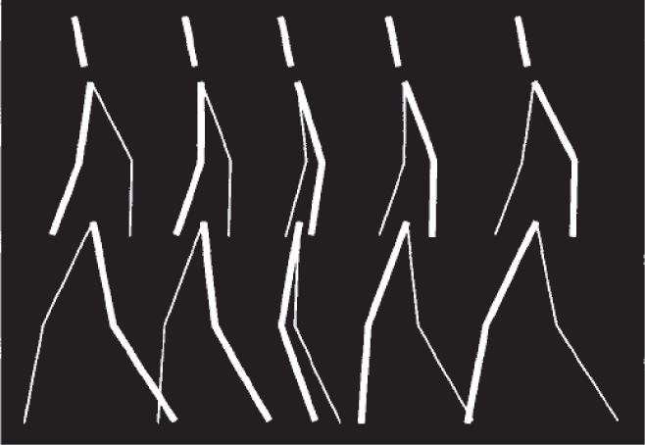
Shape from Motion
A key assumption required to estimate the three-dimensional structure of an object from its motion is that the object is rigid.
For many years, it was thought that the human visual system makes this rigidity assumption. However in 1996 Pawan Sinha and Tomaso Poggio provided a perfect counter-example
Consecutive frames from a screen sequence obtained by rotating a rigid wire-frame matchstick figure back and forth around its vertical axis gives the impression of a person walking.

Slide 49
A Johansson Movie
People will also quickly group sets of moving dots into single biological entities, into something alive.
Gunnar Johansson, back in the early 1970s, created movies of people with points of light at their joints as the people walked, ran, and performed other activities (the points of light were at ankles, knees, hips, wrists, elbows, and shoulders, with one for the head). With the contrast set correctly, all you see is the points of light. When naïve individuals see a single frame from the movie, they can't identify what the dots represent - maybe a Christmas tree. As soon as the motion starts, everyone sees human motion (check out the cool point light walker at the BioMotion Lab Site) https://www.biomotionlab.ca/html5-bml-walker/

Slide 50
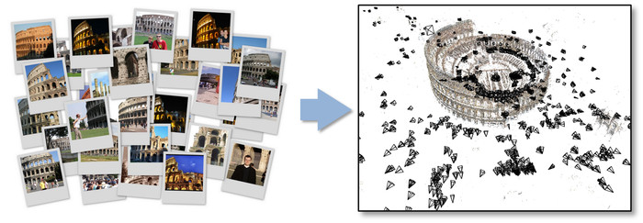
How Much Structure from How Much Motion
Shimon Ullman (1979) obtained a related result based on four points from three views.
His finding follows in a mathematical tradition that can be traced back to a breakthrough requiring five matched points in two views by Erwin Kruppa (1913).
State-of-the art: Noah Snavely Bundler: Structure from Motion (SfM) for Unordered Image Collections

Slide 51
Outline (Ch. 5)
Depth: The Rouge Dimension
Motion: What Is It Good For?
Stereopsis: Stereo Vision
Shape from X
Motion, Stereo, Shading, Texture

Slide 52
Stereopsis: Stereo Vision
Prey and Predators
Disparity Equations: Eyes and Cameras
The Correspondence Problem
3-D Glasses

Slide 53
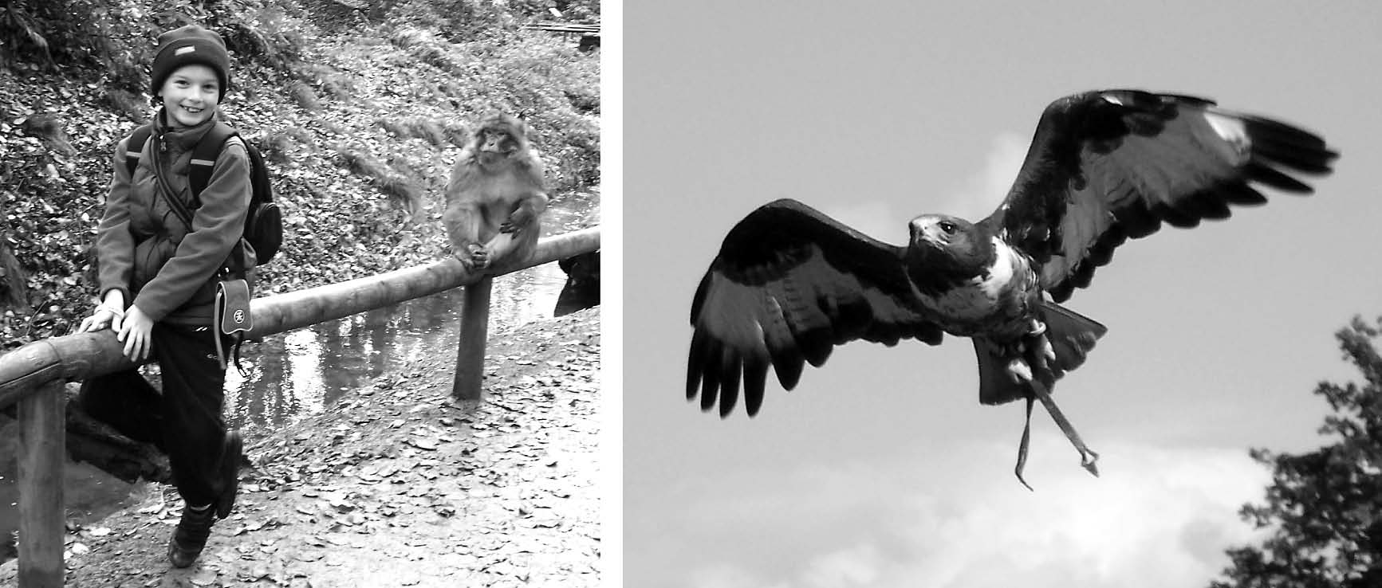

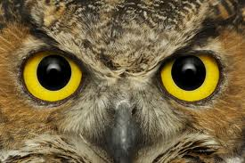

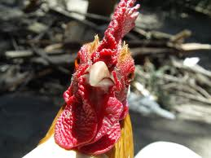
Prey Animals and Predators
Having two eyes enables prey animals like rabbits to see almost all around them: each eye has a large field of view, and there is almost no overlap between the views of their two eyes.
Having two eyes with overlapping views allows predators, such as an eagle or an owl to estimate depth with great accuracy using stereo vision, or stereopsis as it’s known

Slide 54
Stereo Geometry
P(X,Y,Z)
Converging Axes – Usual setup of human eyes
Depth obtained by triangulation
Correspondence problem: p_{l} and p_{r} correspond to the left and right projections of P, respectively.
Notes:
Binocular (or stereo) geometry is shown in the figure. The vergence angle is the angle between the two image planes, which for simplicity we assume are aligned so that the y-axes are parallel. Given either image of the pair, all we can say is that the object point imaged at Pr or Pl is along the respective rays through the lens center. If in addition we know that Pr and Pl are the image projections of the same object point, then the depth of this point can be computed using triangulation (we will return to this in more detail in the section on motion and stereo).
In addition to the camera geometry, the key additional piece of information in stereo vision is the knowledge that Pr and Pl are projections of the same object point. Given only the two images, the problem in stereo vision is to determine, for a given point in the left image (say), where the projection of this point is in the right image. This is called the correspondence problem. Many solutions to the correspondence problem have been proposed in the literature, but none have proven entirely satisfactory for general vision (although excellent results can be achieved in many cases).

Slide 55
A Simple Stereo System
LEFT CAMERA
RIGHT CAMERA
baseline
Left image:
reference
Right image:
target
disparity
Depth Z
Elevation Z_{w}
Z_{w}=0

Slide 56
Disparity Equation
P(X,Y,Z)
Stereo system with parallel optical axes
Depth
Disparity:
d = x_{r} - x_{l}
Image plane
Image plane
p_{l}(x_{l},y_{l})
pr(x_{r},y_{r})
f = focal length
f = focal length
Optical Center O_{l}
Optical Center O_{r}
B = Baseline
LEFT CAMERA
RIGHT CAMERA

Slide 57
Disparity vs. Baseline
P(X,Y,Z)
Stereo system with parallel optical axes
Depth
Disparity
d = x_{r} - x_{l}
Image plane
Image plane
p_{l}(x_{l},y_{l})
pr(x_{r},y_{r})
f = focal length
f = focal length
Optical Center O_{l}
Optical Center O_{r}
B = Baseline
LEFT CAMERA
RIGHT CAMERA

Slide 58
Depth Accuracy
Given the same image localization error
Angle of cones in the figure
Depth Accuracy (Depth Resolution) vs. Baseline
Depth Error ∝ 1/B (Baseline length)
PROS of Longer baseline,
better depth estimation
CONS
smaller common FOV
Correspondence harder due to occlusion
Depth Accuracy (Depth Resolution) vs. Depth
Disparity (>0) ∝ 1/ Depth
Depth Error ∝ Depth²
Nearer the point, better the depth estimation
An Example
f = 16 x 512/8 pixels, B = 0.5 m
Depth error vs. depth
Two viewpoints
O_{l}
O_{r}
Z₁
Z₂
∂Z₁
∂Z₂>∂Z₁
Absolute error
Relative error
Notes:
f = 16 x 512/8 pixels, B = 0.5 m, dZ = Z**2 /2**9 * 1 (pixel)
Z (m) 2 4 8 16 32 64
dZ(m) 1/128 1/32 1/8 ½ 2 8

Slide 59
Human Eye Stereo Geometry
Geometric origin of stereo disparity.
If the eyes separated by a baseline distance of I = 6 cm fixate on a 3D point F of a depth d in the world, then the image of this point falls on the left fovea F_{L}, and also on the right fovea F_{R}. A different 3D point, P, falls on a point P_{L} in the left eye, an angle of v_{L} degrees away from the left fovea F_{L}, and it falls on a point P_{R} in the right eye, v_{R} degrees from the right fovea F_{R}. The difference between the angles v_{L} and v_{R} is the stereo disparity H of the 3-D point P, and can be used to find the depth interval z.
v_{L} - v_{R} = H = cIz/d² degrees
where c = 57.3 degrees/radian

Slide 60
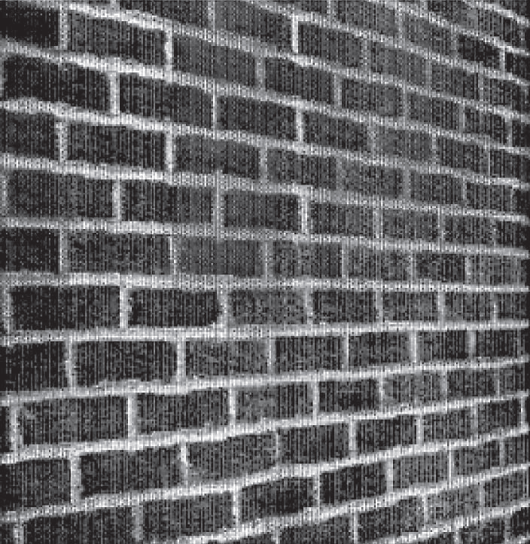
Cyclopean Image
The image is assumed to be centered on a point mid-way between your eyes—the cyclopean center. Within this image, the difference between each pair of corresponding retinal points defines a small directed line that connects them.

Slide 61
Few Important Observations
First, using stereopsis, retinal disparity tells the brain the absolute depth of points only if it knows is the distance d to the fixation point.
Given that the threshold for human stereopsis is about 2 arc seconds (Coutant & Westheimer 1993), this implies that stereopsis can’t provide information about shape (i.e., depth interval) once a 1 cm die is farther than about 2.5 meters away.
Widely spaced eyes should yield more disparity, and therefore more depth information, than eyes that are close together

Slide 62
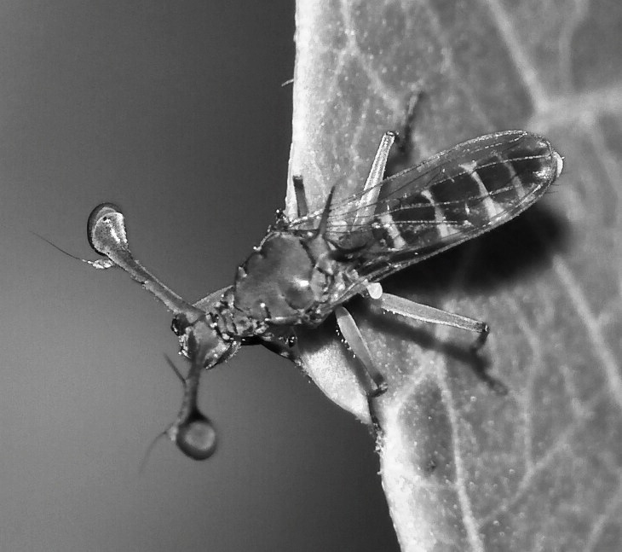
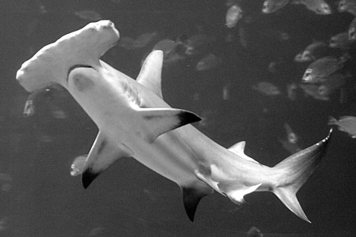
Wide Baselines in the Animal Kingdom
(a) Male stalk-eyed flies (Diopsidae) have eyes up to 5.5 cm apart with overlapping fields of view, which could mean they have stereoscopic vision. Photograph by Hauke Koch from Wikipedia. (b) Hammerhead shark has superb depth perception because its eyes are far apart.

Slide 63
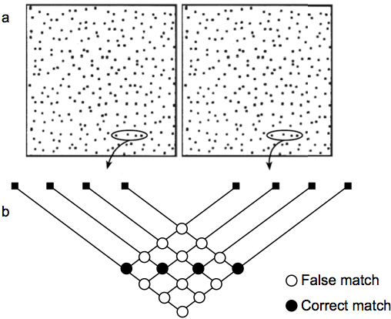
The Correspondence Problem
Stereo correspondence problem. (a) Each point in the left image must be matched with its corresponding point in the right image. Here points are made explicit as dots, and four dots are encircled to exemplify how many ways they can be (mis-)
matched across the two images. (b) Expanded view shows that each dot in the left image can be matched with four dots in the right image (and vice versa), but only one of these matches is correct (black disks), the rest are mismatches (white disks)

Slide 64
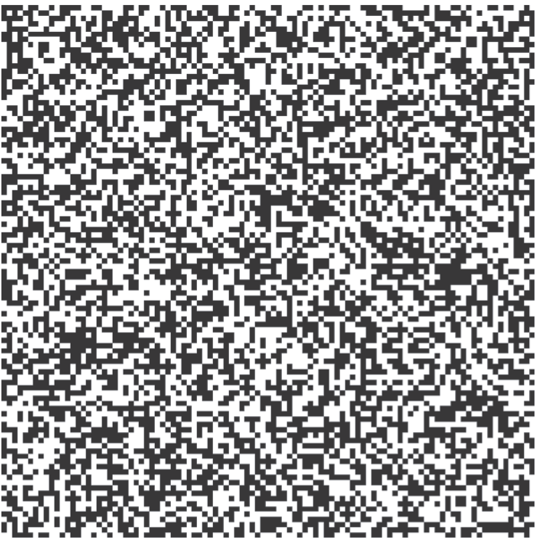
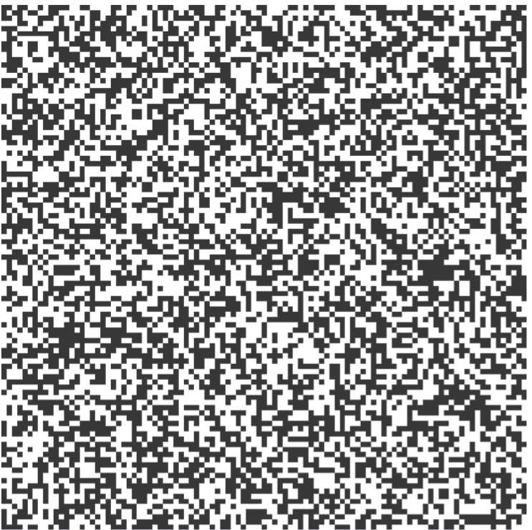
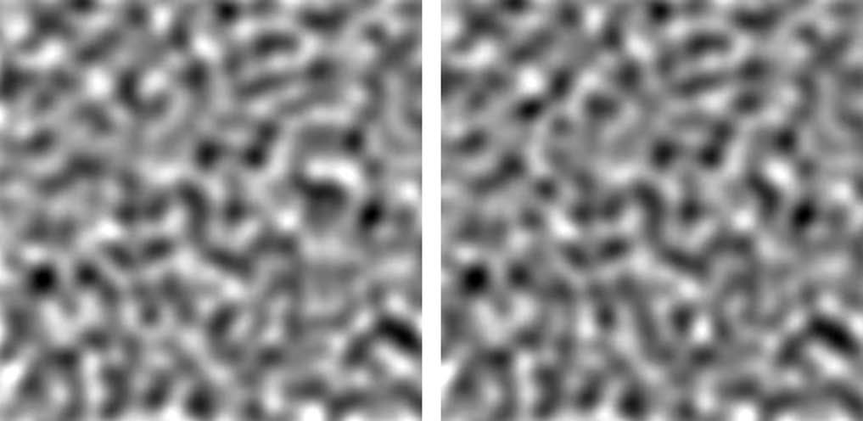
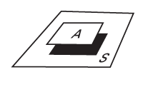
Coarse-to-Fine Strategy
Random-dot stereogram shown on the left, as represented by the outputs of model ganglion cells on the right. Even though most of the fine details (high spatial frequencies) have been removed, the two images can still be fused to reveal the same depth information.

Slide 65
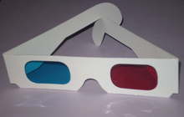
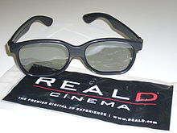
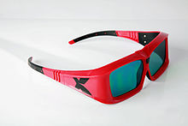

3D Glasses, Movies & Video
Anaglyph 3D glasses
Polarized glasses
Shutter glasses
An HMD with a separate video source displayed in front of each eye to achieve a stereoscopic effect
http://en.wikipedia.org/wiki/Stereoscopy

Slide 66
Outline (Ch. 5)
Depth: The Rouge Dimension
Motion: What Is It Good For?
Stereopsis: Stereo Vision
Shape from X
Motion, Stereo, Shading, Texture

Slide 67
Shape from X
Shape from Motion (Structure from Motion)
Shape from Stereo
Shape from Texture
Shape from Shading

Slide 68

How easily we are fooled

Slide 69

Shape from Texture
The two squares have identical areas on the page, and show how the number of disks per square centimeter of image area increases with surface slant. Courtesy Angeline Loh (2006).

Slide 70

Shape from Shading
(a) To obtain shape from shading, you first have to discount the reflectance or albedo of the surface. (b) Lightness illusion. The same change in image luminance (gray level) can be induced either by a change in surface orientation of a surface with constant reflectance (top circle), or by a change in the reflectance of a surface with constant orientation (bottom circle). Courtesy Ted Adelson.

Slide 71
Outline (Ch. 5)
Depth: The Rouge Dimension
Motion: What Is It Good For?
Stereopsis: Stereo Vision
Shape from X
Motion, Stereo, Shading, Texture

